Slide 1
@Open-Ones Group
How To Do Unit Test?
Duration: 60'
Presenter: Open-Ones Group
Nguyễn Xuân Doãn
Notes:
Version 1.1:
+ Update slide: Flow of stages/phages in SDLC
+ Update Reference:
Software Handbook of Open-Ones Group

Slide 2
Objectives
Understand about the Unit Test fundamentals.
Know the methods to do Unit Test.

Slide 3
Contents
We will discovery this topic through these following questions:
  What is UT?
  Who must do UT?
  Why must do UT?
  How to do UT?

Slide 4
How To Do Unit Test?
Unit Testing actions:
  Validate that individual units of software program are working properly.
  A unit is the smallest testable part of an application (in procedural programming a unit may be an individual program, function, procedure, etc., while in object-oriented programming, the smallest unit is always a method).
Unit Testing products:
  Tested software units.
  Related documents (UT case, UT report, UT code).

Slide 5
How To Do Unit Test?
Unit Testing conductor: DEVELOPER.

Slide 6
How To Do Unit Test?
Why must we do UT?
  Ensure the quality of our programming unit.
  Detect defects and issues soon.
  Reduce the quality effort and correction cost.

Slide 7
How To Do Unit Test?
Cost of bugs
$14,000
% Defects introduced in this phase
85%
% Defects found in this phase
$ Cost to repair defect in this phase
Percentage of Bugs
$1000
$130
$250
$25
Coding
Unit
Test
Funct
Test
Field
Test
Post
Release
Source: Applied Software Measurement,
Capers Jones, 1996

Slide 8
How To Do Unit Test?
When must we do UT?
  After Coding
  Before Integration Test
Stage Bug Inject
Stage bug Detect
BD
ST
FD
IT
Test Case Creation
DD
UT
Code
Desk
Debug

Slide 9
How To Do Unit Test?
There are 2 methods of testing:
  Black-box testing (Functional)
    Specification derived tests
    Equivalence partitioning
    Boundary value analysis
  White-box testing (Structural)
    Statement coverage
    Decision (branch) coverage
    Path coverage

Slide 10
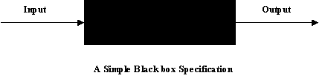
How To Do Unit Test?
Black-box testing
  Functional testing: ensure each unit acts right as its specification.
  Business testing: ensure the software program acts right as user requirement.

Slide 11
How To Do Unit Test?
Black-box testing (cont.)
  Specification derived test
    Choose all or some statements in the specification of module.
    Create test cases for each statements of specification.
    Execute test cases to check test result will outputs as the specification.
  Example: we have a specification as below:
    Input - real number, Output - real number
    When given an input of 0 or greater, the positive square root of the
    input shall be returned.
    When given an input of less than 0, the error message "Square root
    error - illegal negative input" shall be displayed and a value of 0 returned.

Slide 12
How To Do Unit Test?
Black-box testing (cont.)
  Test case 1: input 4, return 2
    Use the first statement in the specification.
    When given an input of 0 or greater, the positive square root of the input shall be returned.").
  Test case 2: input -10, return 0,
  output “Square root error – illegal negative input”
    Use the second and third statements in the specification.
    ("When given an input of less than 0, the error message "Square root error - illegal negative input" shall be displayed and a value of 0 returned.”).

Slide 13
How To Do Unit Test?
Black-box testing (cont.)
  Equivalence partitioning
    Divide the input of a program into classes of data from which test cases can be derived. This might help you to reduce number of test cases that must be developed.
    Behavior of software is equivalent for any value within particular partition
    A limited number of representative test cases should be chosen from each partition.

Slide 14
How To Do Unit Test?
Black-box testing (cont.)
  Equivalence partitioning
    Test Case 1: Input 4, Return 2
      Use the >=0 input partition (1)
      Use the >=0 output partition (a)
    Test Case 2: Input -10, Return 0, Output "Square root error - illegal negative input“
      Use the < 0 input partition (2)
      Use the “Error” output partition (b)
Input partitions |  | Output partitions
1 | >= 0 | a | >= 0
2 | < 0 | b | Error

Slide 15
How To Do Unit Test?
Black-box testing (cont.)
  Boundary value analysis
    It is similar to equivalence partitioning, is a selection of test cases, test input that check bounding values
    Anticipate that errors are most likely to exist at the boundaries between partitions
    Test the software at either side of boundary values
Input Partitions (1) (2) - 0 + 1 2 3 4 5 Boundaries and test cases

Slide 16

How To Do Unit Test?
White-box testing
  Developer does himself
    Check syntax of code by compiler to avoid syntax errors
    Run code in debug mode, line by line, through all independent paths of program to ensure that all statement of codes has been executed at least one time
    Examine local data structure to ensure that data stored temporarily maintains its integrity during all all steps of code execution
    Check boundary conditions to ensure that code will run properly at the boundaries established as requirements
    Review all error handling paths

Slide 17
How To Do Unit Test?
White-box testing
  Example
A
  buy(dress, bag) {
  if dress already in bag
  display “already bought it”
  else
  if bag is full
  display “bag is full”
  else
  buy dress
  display “buy successful”
  end if
  end if
  }
A
B
B
C
C
D
D
E
E
F
F
G
G

Slide 18
How To Do Unit Test?
White-box testing (cont.)
  Statement coverage C0
A
A
Total Nodes = 7;
Test case ABG covers 3 = 43%
+ Test case ACDFG
=> covers 6/7 = 86%
Need 1 more for 100% statement coverage ACEFG
C
B
C
B
D
D
E
E
F
F
G
G

Slide 19
How To Do Unit Test?
White-box testing (cont.)
  Decision (branch) coverage C1
A
What branch coverage is achieved by ABG, ACDFG, ACEFG?
4 in total.
4 covered
So 4/4 = 100% branch coverage
A
C
B
C
B
D
D
E
E
F
F
G
G

Slide 20
How To Do Unit Test?
White-box testing (cont.)
  Path coverage C4
A
A
What path coverage is achieved by ABG, ACDFG, ACEFG?
3 in total.
3 covered
So 3/3 = 100% path coverage
C
B
C
B
D
D
E
E
F
F
G
G

Slide 21
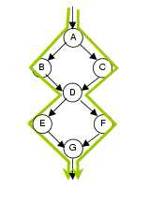
How To Do Unit Test?
White-box testing (cont.)
Test cases covering ABDEG and ACDFG cover 4/4 branches (100%) and 7/7 statements (100%)
They, however, only cover 2/4 paths (50%).
2 more tests are required to achieve 100% path coverage:
ABDFG
ACDEG

Slide 22
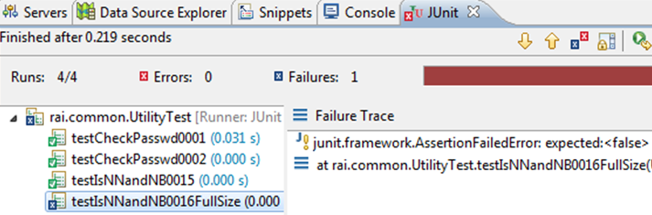

How To Do Unit Test?
UT tools:
  Java: JUnit
  C/C++: cppUnit
  Python: pyUnit
  Perl: PerlUnit
  Visual Basic: vbUnit
  C# .NET: Nunit,csUnit
Tools for coverage C0, C1:
  djUnit
  Emma

Slide 23
How To Do Unit Test?
Summary
  What is UT?
  Who must do UT?
  Why must do UT?
  How to do UT?

Slide 24
How To Do Unit Test?
References
  Public FPT Software's CMMi documents
http://ict-industry.gov.vn/Clients/Document/DownloadDocument.aspx?Me=Document&ID=1
  Wiki
http://en.wikipedia.org/wiki/Unit_testing
  Software Handbook of Open-Ones Group
https://open-ones.googlecode.com/svn/trunk/OOG-Handbook

Slide 25
Discussion

Slide 26
How To Do Unit Test?
Quizzes
  You find bugs while coding, is it unit test activity? Why?
  Which cases we apply Black-box and White-box testing?
  What are the result if we do not perform Unit test?
  As your opinion, what is the most difficult in Unit test activity?
  What are the products of Unit test activity?

